Slide 1
Intro to Java (Page 3)
JUMP June 2019
Draft: 07/08/2019

Slide 2
Table of Contents
Exception Handling
Input / Output (I/O)

Slide 3
Exception Handling
The Exception Chain and Hierarchy
And if you don’t handle them..
Using Multiple “catch” statement
Creating Subclass Exceptions and Exception Superclasses
Nested Try Blocks
Throwing an exception on purpose
The “Throwable” Object
“finally”
“throws”
Java’s Built-In Exceptions

Slide 4
Exception Handling – The Exception Chain and Hierarchy
In Java all exceptions are represented by classes
All are derived from the “Throwable” class
Two direct subclass of “Throwable” are:
Exception: errors that occur in your app
Example: divide-by-zero, array out-of-bound, file errors are these types of errors
RuntimeException are errors that occur directly at runtime
Error: errors that occur in the JVM itself, not your app

Slide 5
Exception Handling – The Exception Chain and Hierarchy
Exception handling is managed via 5 keywords
try
catch
throw
throws
finally
They form a subsystem in which the use of one implies the use of another.
try {
// block of code to monitor for errors
}
catch (ExcepType1 exOb) {
// handler for ExcepType1
}
catch (ExcepType2 exOb) {
// handler for ExcepType2
}

Slide 6
Exception Handling – The Exception Chain and Hierarchy
Example of code where an error is generated in a method, but caught in a try catch block.
See live code in STS “SimpleException2”

Slide 7
Exception Handling – And if you don’t handle them..
The reason for catching exceptions is to prevent abnormal program termination.
If your app doesn’t catch the exception, the JVM will.
When the JVM catches an error, it will terminate the app and display a stack trace and error message.
// Let JVM handle the error.
class NotHandled {
public static void main(String args[]) {
int nums[] = new int[4];
System.out.println("Before exception is generated.");
// generate an index out-of-bounds exception
nums[7] = 10;
}
}

Slide 8
Exception Handling – And if you don’t handle them..
// This won't work!
class ExcTypeMismatch {
public static void main(String args[]) {
int nums[] = new int[4];
try {
System.out.println("Before exception is generated.");
//generate an index out-of-bounds exception
nums[7] = 10;
System.out.println("this won't be displayed");
}
/* Can't catch an array boundary error with an ArithmeticException. */
catch (ArithmeticException exc) {
// catch the exception
System.out.println("Index out-of-bounds!");
}
System.out.println("After catch statement.");
}
}
In this example we are not using the correct exception handler.

Slide 9
Exception Handling – Using Multiple “catch” statement
Exception handling can be set to deal with multiple types of errors by chaining catch blocks.
See live code in STS “SimpleException4”
See live code in STS “SimpleExceptionMultiCatch”

Slide 10
Exception Handling – Creating Subclass Exceptions and Exception Superclasses
It is possible to catch all errors using “Throwable”
It is also possible to create our own.
See live code in STS “SimpleException5”
See live code in STS “SimpleExceptionSubclass”

Slide 11
Exception Handling – Nested Try Blocks
It is possible to nest Try blocks
See live code in STS “SimpleException6”

Slide 12
Exception Handling – Throwing an exception on purpose
While the idea of throwing an exception on purpose may seem crazy, it is actually beneficial to be able to do so, if only for testing purposes to ensure your code is running correctly.
See live code in STS “SimpleException7”
We can also “rethrow” an Exception, the reason is that this way allows multiple handlers to access the exception. At some point, you will want to create your own custom exceptions as part of your overall code management and design strategy and it will be important to handle errors for multiple handlers under a single exception.
See live code in STS “SimpleException8”

Slide 13
Exception Handling – The “Throwable” Object
All exceptions support the methods defined by “Throwable”
printStackTrace() : Display a standard error message plus a record of the method call(s) that lead up to the exception.
toString(): to retrieve the standard error message.
Method | Description
Throwable fillInStackTrace( ) | Returns a Throwable object that contains a completed stack trace. This object can be rethrown.
String getLocalizedMessage( ) | Returns a localized description of the exception.
String getMessage( ) | Returns a description of the exception.
void printStackTrace( ) | Displays the stack trace.
void printStackTrace(PrintStream stream) | Sends the stack trace to the specified stream.
void printStackTrace(PrintWriter stream) | Sends the stack trace to the specified stream.
String toString( ) | Returns a String object containing a complete description of the exception. This method is called by println( ) when outputting a Throwable object.
See live code in STS “SimpleException9”

Slide 14
Exception Handling – “finally”
Code which must execute at all time after the handling of the exception.
Basically, after the try/catch has executed, “finally” will execute as well.
See live code in STS “SimpleExceptionFinally”

Slide 15
Exception Handling – “throws”
In some cases, if a method generates an exception that it does not handle, it must declare that exception in a throws clause. Here is the general form of a method that includes a throws clause:
ret-type methName(param-list) throws except-list {
// body
}
The exceptions can be a listed separated by commas.
See live code in STS “SimpleIOException”

Slide 16
Exception Handling – Java’s Built-In Exceptions
Inside the java.lang standard package, Java defines several exception classes.
The most general of these exceptions are subclasses of the standard type “RuntimeException”.
“java.lang” is implicitly imported in all Java programs
Most exceptions from “RuntineException” are automatically available and need not be included in any method’s “throws” list.
These are called “unchecked exceptions” because the compiler does not check to see if a method handles or throws these exceptions.
For more information on exceptions, please follow the link: https://www.geeksforgeeks.org/types-of-exception-in-java-with-examples/

Slide 17
Input/Output (I/O)
Java I/O is all about Streams
Byte Streams and Character Streams
The Byte Stream Classes
The Character Stream Classes
The Predefined Streams
Using the Byte Streams
Reading and Writing Files using Byte Streams
Automatically Closing a File
Reading and Writing Binary Data
Random-Access Files
Java’s Character-Based Streams
File I/O Using Character Streams
Using Java’s Type Wrappers to Convert Numeric Strings

Slide 18
Input/Output (I/O) - Java I/O is all about Streams
Java programs perform input/output (I/O) through streams
An I/O Stream is an abstraction that either produces or consumes information.
A stream is linked to a physical I/O device by Java
All streams behave in the same manner even if the physical devices differ
Same I/O classes and methods can be applied to different types of devices

Slide 19
Input/Output (I/O) - Byte Streams and Character Streams
There are 2 types of I/O streams
Byte
Character
Byte streams are great for handling input and output of bytes, for example the reading and writing of binary data
Character streams use Unicode and can be internationalized.
At the lowest of levels, all I/O streams are in fact at the byte level, but we have many classes which abstract the harsh coding necessary to implement such features

Slide 20
Input/Output (I/O) - The Byte Stream Classes
Byte Streams are defined using two class hierarchies
InputStream
OutputStream
This is all about reading and writing to various devices including hard disk drives
http://ecomputernotes.com/java/stream/byte-stream-classes

Slide 21
Input/Output (I/O) - The Character Stream Classes
Character streams are defined by using two class hierarchies
Reader
Writer
http://ecomputernotes.com/java/stream/java-character-stream-classes

Slide 22
Input/Output (I/O) - The Predefined Streams
With the “java.lang” package comes a class defined as “System”.
“System” encapsulates several aspect of run-time environment
It contains 3 predefined stream variables
“in”
“out”
“err”
These fields are declared as public final and static within System. This means they can be used by any other part of your program without reference to a specific System object (no instantiation)
“System.out”: your standard output stream, by default the console.
“System.in”: your standard input stream, by default the keyboard.
“System.err”: your standard error stream which is also by default the console.
Note: All streams can be redirected to any compatible I/O device.

Slide 23
Input/Output (I/O) - Using the Byte Streams
InputStream and OutputStream can throw an IOException error
Can be used to read console input, although it is preferable to use a character stream.
https://docs.oracle.com/javase/7/docs/api/java/io/InputStream.html
https://docs.oracle.com/javase/7/docs/api/java/io/OutputStream.html
See live code in STS “IOReadBytes”

Slide 24
Input/Output (I/O) - Reading and Writing Files using Byte Streams
Use FileInputStream and FileOutputStream for I/O disk based operations.
See live code in STS “IOReadTextFile”
See live code in STS “IOWriteFile”

Slide 25
Input/Output (I/O) - Automatically Closing a File
Using a Try with Resources technique is basically to ensure that the resource will be closed regardless of any issues arising
This prevents memory leaks.
See live code in STS “IOTryWithResources”

Slide 26
Input/Output (I/O) - Reading and Writing Binary Data
DataInputStream https://docs.oracle.com/javase/7/docs/api/java/io/DataInputStream.html
DataOutputStream https://docs.oracle.com/javase/7/docs/api/java/io/DataOutputStream.html
See live code in STS “IODataOutputStream”

Slide 27
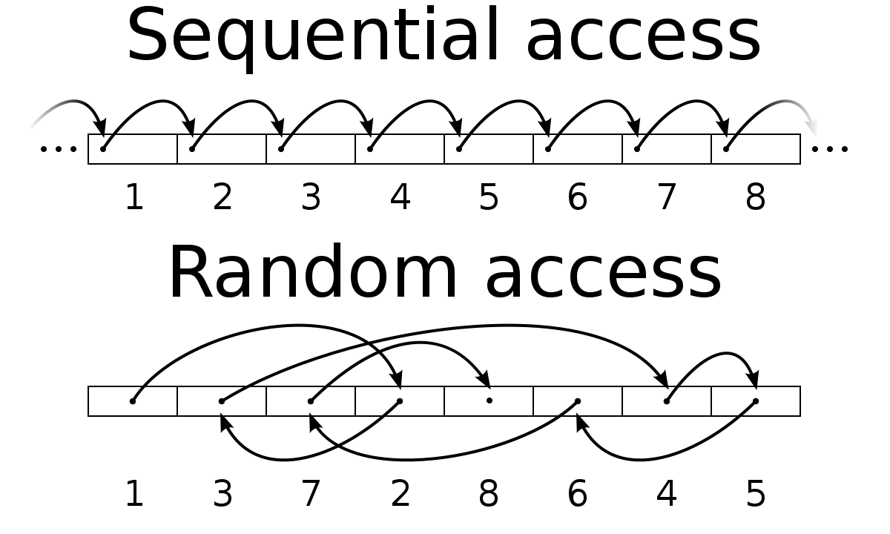
Input/Output (I/O) - Random-Access Files
All the files we’ve read so far have been read ‘sequentially’.
Random-Access Files read and write is about reading or writing data by setting a file pointer. With Random Access capability, you are using file positioning to determine the location of your operation within the file.
See live code in STS “IORandomAccess”

Slide 28
Input/Output (I/O) - Java’s Character-Based Streams
Reader https://docs.oracle.com/javase/7/docs/api/java/io/Reader.html
Writer https://docs.oracle.com/javase/7/docs/api/java/io/Writer.html
Note: the best class for reading from the console is the BufferedReader…
See live code in STS “IOBufferedReader”

Slide 29
Input/Output (I/O) - File I/O Using Character Streams
FileReader
FileWriter
See live code in STS “IOFileReader”
See live code in STS “IOFileWriter”
See live code in STS “IOReadLines”

Slide 30
Input/Output (I/O) - Using Java’s Type Wrappers to Convert Numeric Strings
Easy and convenient way to read numerical strings
Support for primitives: Float, Long, Integer, Short, Byte, Character, and Boolean.
See live code in STS “IOTypeWrappers”

